Slide 1
Introduction to Advertising History and its Roles
By
Ms Gunjan Sharma
Assistant Professor
Subharti Institute of Journalism & Mass Communication

Slide 2
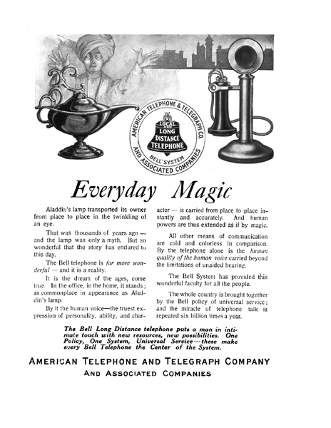
What is Advertising?

Slide 3
Advertising is:
AMA (American Marketing Association ) Defines
“Advertising is any form of Non personal presentation of goods, services or ideas for action openly paid for by an Identified Sponsor using Mass Media to Persuade or Influence one or more person.”
.

Slide 4
Advertising is:
structured and composed nonpersonal communication of information,
usually paid for and usually persuasive in nature,
about products (goods, services, and ideas)
by identified sponsors through various media

Slide 5
Functions of Advertising
Provide Product &
Brand Information
Provide Incentives
To Take Action
Advertising
Performs 3 Basic
Functions
Provide Reminders and
Reinforcement

Slide 6
Functions :

Slide 7
Advertising Campaigns
a series of coordinated advertisements
single advertisement placed in multiple media
several different advertisements with a similar look, feel, and message

Slide 8
The Key Players
Advertiser (client)
Agency
Media
Audience/ Consumer
Uses advertising to send out a message about its products, Service or ideas etc.
Approves audience, plan and budget
Advertiser could be any one organization, institution, government, marketers etc.

Slide 9
The Key Players
Advertiser (client)
Agency
Media
Audience/ Consumer
They Plan, Produce and place the adver-tisement in the media
Has strategic and creative expertise, media knowledge, workforce talent, and negotiating abilities
Advertising department
In-house agency

Slide 10
The Key Players
Advertiser (client)
Agency
Media
Audience/ Consumer
The channels of communication that carry the message to the audience
Mass media advertising can be very effective because the reach of mass media is very high i.e Print /Radio/ Television/ New Media

Slide 11
The Key Players
Advertiser (client)
Agency
Media
Audience/ Consumer
The Targeted audience for the advertising message
Data-gathering technology improves accuracy of information about customers

Slide 12
Roles of Advertising
Marketing Role
Communication Role
Marketing is the process a business uses to satisfy consumer needs and wants through goods and services.
Economic Role
Advertising is a form of mass communication.
Societal Role
Improves standard of living and the economy by generating material consumption.
Informs us about new and improved products, teaches us how to use these innovations, etc.

Slide 13
Roles of Advertising
The process a business uses to satisfy consumer needs by providing goods and services
Product category
Target market
Marketing mix –
Above the line media/
Below the line media
Brand
Marketing
Communication
Economic
Societal

Slide 14
Roles of Advertising
Marketing
Communication
Economic
Societal
Can reach a mass audience
Create the image of product
Explains importance of the product
Recall the product
Persuades

Slide 15
Roles of Advertising
Marketing
Communication
Economic
Societal
Moves from being informational to creating demand and consumer purchase the product .
Advertising increases the price sensitivity and stimulates competition.

Slide 16
Roles of Advertising
Marketing
Communication
Economic
Societal
Informs consumers about new improved product
Mirrors fashion and design trends
Teaches consumers about the use of new products
Helps to compare the product
Improves lifestyle

Slide 17
Classifications of Advertising
By Target Audience
By Geographic Area
By
Medium
By
Purpose
Consumer
Business
• Local (retail)
• Regional
• National
• International
Print
Broadcast
(electronic)
– Radio
– TV
Out-of-Home
Direct-Mail
Transit Media
• Product
• Nonproduct
• Commercial
• Noncommercial
• Action
• Awareness

Slide 18
Historical Roles of Advertising
The Pre-industrial Age (pre-1800)
The Industrializing - Production Era (To WW1)
The Industrial - Sales Era (1900’s to 1970s)
The Post Industrial - Marketing Era (Starting 1980)
The Global Interactive – Creative Era

Slide 19
Pre-industrialization era (pre-1800)
Printed advertisements appeared in news books
Advertisements were dominated by simple announcements by skilled laborers
The era of industrialization (1800-1875)
Circulation of the dailies
New opportunities due to the railroads and growing urban centers
No laws or regulations to restrict advertisers

Slide 20
The Production Era (1875 to 1918)
Advertising was based on consumer culture
Consumer culture: Way of life centered on consumption
Advertising became a full-fledged industry
Brands were preferred to unmarked commodities
Pure Food and Drug Act: Required manufacturers to list the active ingredients of their products on their labels
Social and cultural changes opened up opportunities for advertisers

Slide 21
The Sales Era 1920s
Advertising found respectability, fame, and glamour
Consumers were instructed how to be modern and avoid the pitfalls of this age
Chain of needs: Needs lead to products that lead to new needs, which is remedied by new products that further lead to newer needs and so on
Women became primary target
Role of science and technology began to play

Slide 22
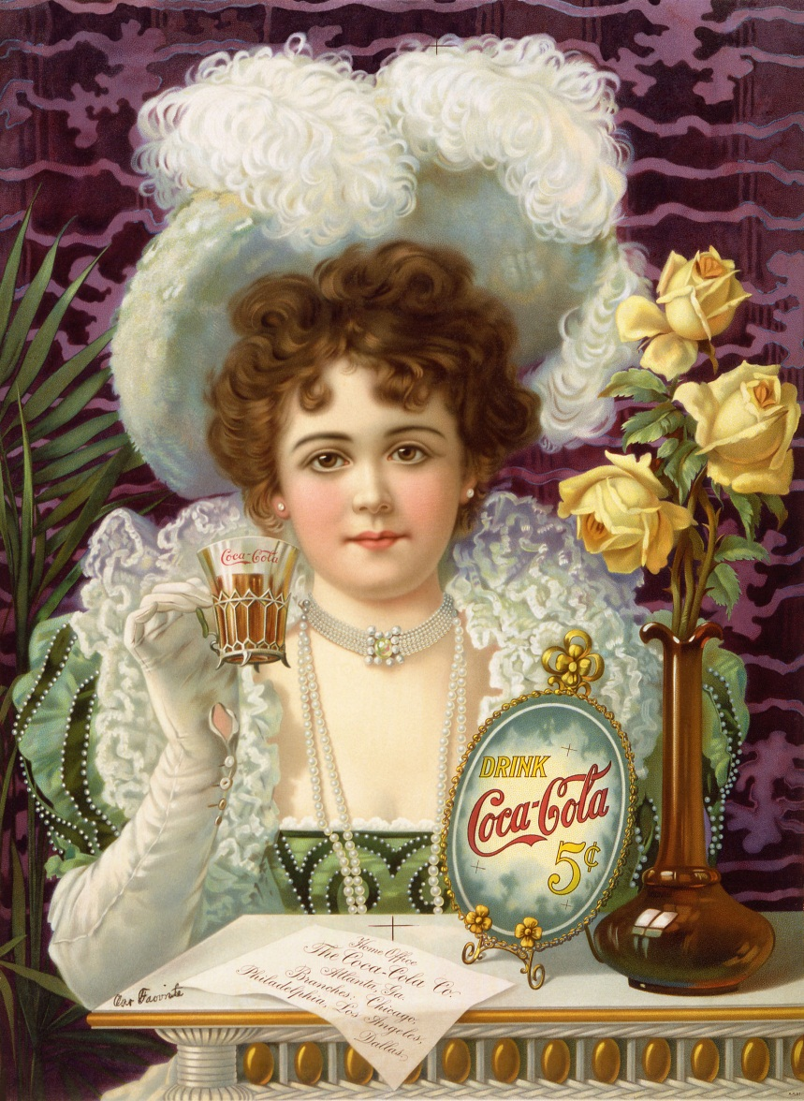
A Coca-Cola
advertisement from the 1890s

Slide 23
During the 1920s, an important advertising logic is that good times always come with side effects, and then a product to remedy the side effect.

Slide 24
World War II and the 1950s Marketing Era
Advertised brands were linked with patriotism
Economy and consumption improved
Consumers feared being manipulated by modern science, technology, and subliminal advertising
Subliminal advertising: Subconscious advertising, which influenced consumers to buy things they did not need or want

Slide 25
creative revolution (1960 to 1972)
Ads started to take on the themes, the language, and the look of the 1960s
Women and other minorities were portrayed in submissive roles
Characterized by the creatives
Advertising became a symbol of consumption itself

Slide 26
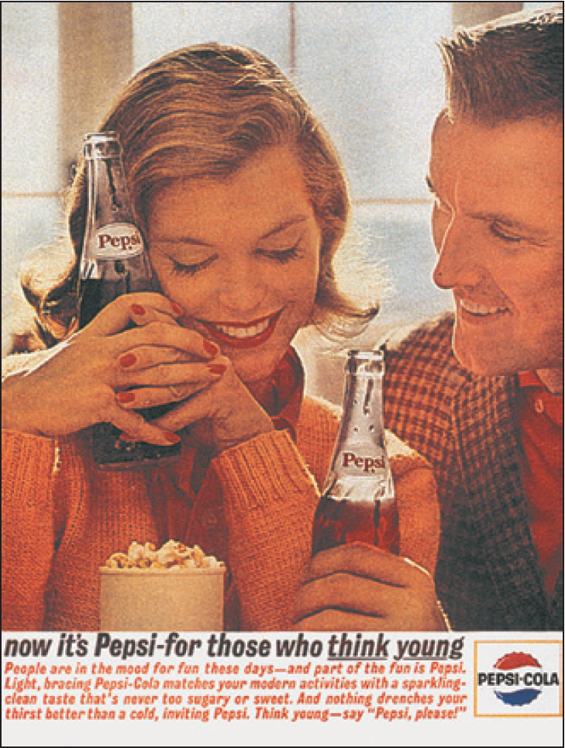
Pepsi created a generation and traded on the discovery of the vast youth market. Pepsi claimed youth as its own.
Courtesy, Pepsi-Cola Company
©2015 Cengage Learning. All Rights Reserved. May not be scanned, copied or duplicated, or posted to a publicly accessible website, in whole or in part.

Slide 27
History of Indian Advertising

Slide 28
Pre Independence
Press advertisements – largely imported goods which had reached Indian shores.
Dattaram , the first agency , was found in 1905. it released the first ad for West End Watch Co., Mumbai in 1907.
In 1920, the banner ad was put on trams.

Slide 29
The first classified advertisement in India appeared in Hicky's Bengal Gazette, in 1780, in Calcutta. However, modern Indian advertising can be traced to the late 1920s .

Slide 31
1930’s
The talkies and radio emerge as media.
1940’s
Famine
Fight for Independence
In 1941, Leela Chitnis became the first Indian film actress to endorse Lux soap

Slide 33
1950’s
Industrial revolution in the Nehruvian era
Burmah Shell propagated kerosene by advertising on Vans
Cinema advertising began
In 1956, Kolkata gets the privilege of India’s first ad club
In 1957 government launches Vividh Bharati
Leading ad agency - Press Syndicate

Slide 34
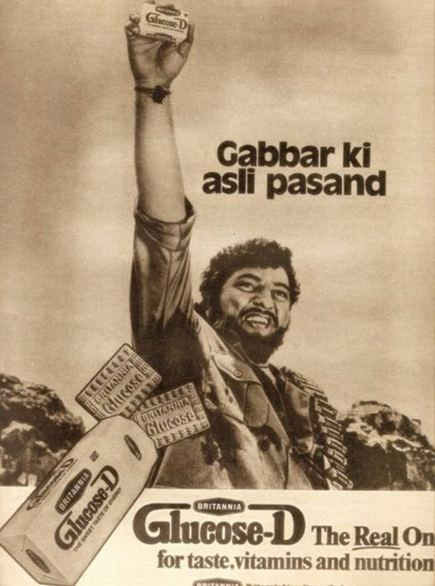

Slide 35
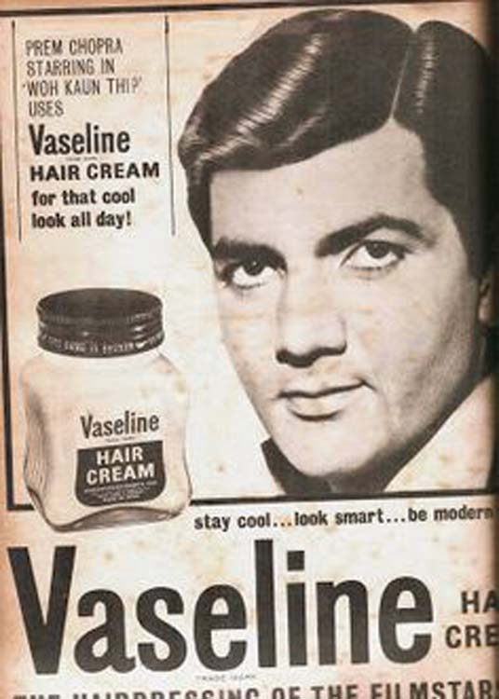

Slide 37
1960’s
India’s first Advertising Convention (1960)
Advertising to to be Indian in thought and content
Shift to marketing orientation
Professionalisation within agencies
1st Asian Advertising Congress at New Delhi
Research data generated

Slide 38
Cont’d….
MRI (Market Rating Indices)
Shop Audits
National Readership Survey(NRS) I and II
Creativity was emphasized
Photography find increasing use
Social marketing

Slide 39
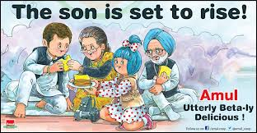

Slide 40
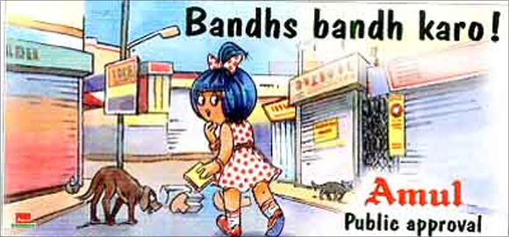

Slide 42
1970’s
Media boom
Special magazines
2nd Asian Advertising Congress at New Delhi
Lifestyle studies, positioning
Rural marketing
In 1978 India's first TV Commercial goes on air

Slide 43
In 1986, Mudra Communications created India’s first folk-history TV serial Buniyaad which was aired on Doordarshan; it became the first of the mega soaps in the country.

Slide 45
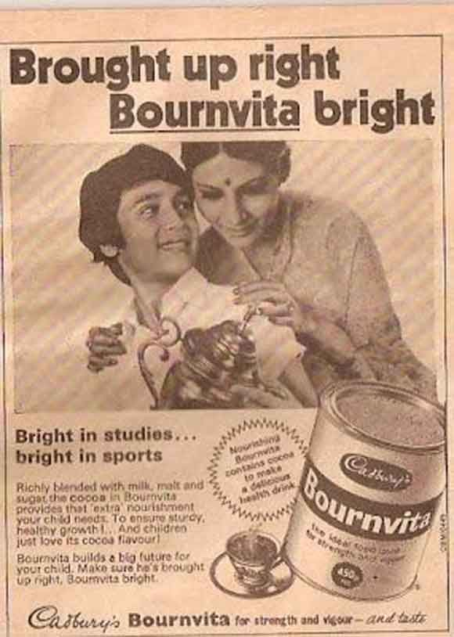

Slide 46
1980’s
Indianisation of western advertising
Public sector advertising
Expansion and diversification of agencies
Aug 15th 1982 – Colour TV introduced
Radio commercials introduced(1982)
NRS by IMRB(Indian Market Research Bureau- national marketing research and business consultant agency formed in 1970 )
Colour Printing more popular
1986 - India’s first TV Ratings System
Notes:
Nirma
NRS-----National readership survey

Slide 47
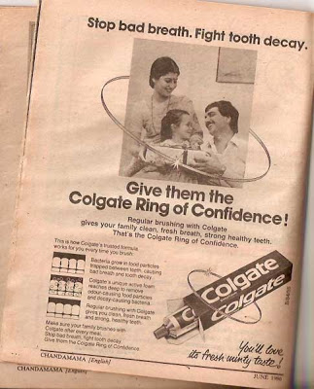

Slide 48
Cont’d….
Regional broadcasts, expansion of radio
Formation of Indian chapter of International Advertising Association
Formation of Advertising Standards Council of India(ASCI)
Concept of sponsored programmes on TV
Notes:
India’s 1st soap opera HUM LOG is on air.
Nirma offers stiff competition to multinational brands.

Slide 49
1990’s
NRS-IV ( 2 surveys – ORG and IMRB-)
Niche magazines
Emphasis on Direct marketing
Satellite TV(1991)
CNN – 1st channel to be beamed to India
Star bouquet
Zee bouquet(1992)
DD Metro to counter satellite channels

Slide 50
DD Audience surveys
Movie channels and pay channels
FM Radio
Emphasis on Brand Equity
Internationalization of Advertising
NRS V-VI & IRS survey in 1997
Consumer Tracking and Satisfaction studies

Slide 51
In 1991, First India satellite channel, Zee TV started its broadcast.
1995 saw a great boom in media boom with the growth of cable and satellite This decade also saw the growth of public relations and events and other new promotions that various companies and ad agencies introduced. Advertising specific websites were born, one of them being agencyfaqs now known as afaqs.

Slide 52
2000
Internationalization of domestic agencies
Net Advertising
The role of the advertising agency – changing to that of a marketing consultant

Slide 53
Thanks

