Slide 1
INTRODUCTION TO ENVIRONMENTAL STUDIES
FAHEEM AHAMAD
Assistant Professor
SWAMI VIVEKANAND SUBHARTI UNIVERSITY
MEERUT-250005, UTTAR PRADESH, INDIA

Slide 2
Definition of Environment and Environmental studies
The word environment is derived from the French word, "Environ" which means "Total Encircle".
Everything which envelops us may be referred to as Environment and the study which covers the different aspects of environment, it’s structure, function and maintenance of its quality including conservation of its living and non living constituents can be collectively referred to as “Environmental Studies”.
Therefore all the physical and cultural factors and conditions which influence the development of an organism or group of organism is known as environment.

Slide 3
Major characteristics of the environment
Following are the main characteristics of the environment-
Living and non-living components are the main constituents of the environment.
Conditions surrounding the living beings create environment.
Mutual existence is the main feature of environment.
Environment is dynamic in nature. Energy from the sun is the main cause for dynamic nature of the environment.
Environment is the habitat of organism.
In environment natural resource are abundant.
Organism in environment adapt according to the changing environment.

Slide 4
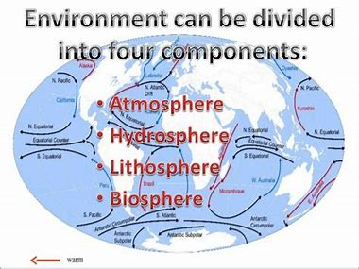
Components of Environment

Slide 5
Lithosphere
The Word lithosphere refers to the layer of rock material on the earth's surface both on the continents and ocean floors.
In simple words, the rocky portion of environment is known as lithosphere.
Lithosphere includes the study of rocks, land forms and soil, the actual medium of growth of plants, animals and micro-organism.
Soil is thin veneer that covers the most of the earth's surface.
Soil is generally composed of sand, silt, clay particles, organic matter (Humus), water and air space.
Soil is non-renewable resource.

Slide 6
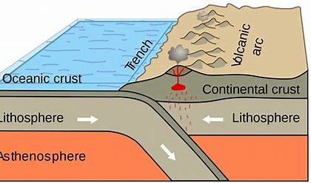
Average composition of earth’s crust with respect to major components is (WR %)
SN | Element | Percentage
1 | Oxygen | 46.6%
2 | Calcium | 3.63%
3 | Silicon | 27.7%
4 | Magnesium | 2.09%
5 | Aluminum | 8.3%
6 | Sodium | 2.83%
7 | Iron | 5%
8 | Potassium | 2.59%

Slide 7
Hydrosphere
Hydrosphere is the layer of water at or near the earth's surface.
Aquatic bodies can be divided into two categories -
1. Lentic: - Means stagnant water such as pond, lakes etc.
2. Lotic:- Means running water such as rivers, streams etc.
Pacific Ocean is the deepest of all the oceans and covers 1/3rd of earth's surface.
Atlantic Ocean is roughly half the size of the Pacific Ocean, covers about 1/6th of earth's surface.
Indian Ocean is smaller than the Atlantic Ocean.
Arctic ocean is the smallest and the shallowest.
Antarctic ocean is also known as southern ocean and austral ocean.

Slide 8
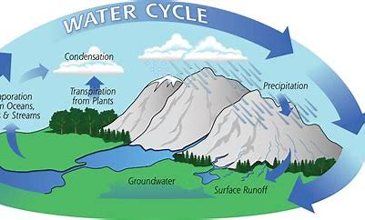
Hydrological cycle
Continuous exchange of water between the ocean, atmosphere and biosphere through evaporation (including transpiration), condensation and precipitation is known as Hydrological cycle.

Slide 9
Atmosphere
Blanket of gases or vapours that surrounds the earth, and held together by the force of gravity is known as atmosphere.
Typical composition of atmosphere is-
97% of the effective atmosphere is up to the height of 29Km.
About half of the air mass is confines within 6.5Km height above sea level and 99.9% within the first 100Km.
SN | Element | Percentage
1 | Nitrogen | 78.08%
2 | Oxygen | 20.95%
3 | Carbon dioxide | 0.034%
4 | Water Vapour | 0-4%
5 | Argon | 0.93%

Slide 10
Lapse Rate
Lapse Rate: Laps rate is the change in temperature with respect to height. It is is of two types:-
a): Positive lapse rate: if temperature decreases with the increase in height.
Temperature Height
b): Negative lapse rate: if temperature increases with the increase in height.
Temperature Height

Slide 11
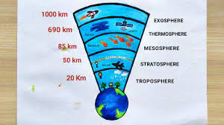
Following are the layers of the atmosphere-

Slide 12
Troposphere
1st Layer of the atmosphere.
Closest layer to the earth.
About 80% of the atmospheric mass is contained within it.
Thickness varies from 17.5Km at the equator to about 6.4Km at poles averaging about 12Km.
Most of the cloud and weather system occur in this region.
Heavy gases occupy this zone e.g CO2 which also effects the temperature change along the height across this zone.
Lapse rate is positive.

Slide 13
Stratosphere
2nd Layer of the atmosphere.
Starts from tropopause and stretch up to 50 km, therefore its thickness is 38 km.
At poles layer is thinner than equator due to intensity of sun being less at poles. (UV rays from sun help in ozone formation)
Devoid of weather phenomenon and is nearly free from moisture and dust.
Air is thinner in this layer as compared to troposphere.
Ozone is present in this layer of Atmosphere.
Stratosphere is significant for the flight of jet planes and for radio communication.
Lapse rate is negative in this layer.

Slide 14
Mesosphere
3rd layer of the atmosphere.
Lies above the Stratosphere and extends to about 85km.
Thus thickness = 35 km.
Dissociation of oxygen molecule, ionisation of the oxygen atom, oxygen molecule and nitrogen molecule occurs in this region.
Mesosphere is the region of minimum temperature (coldest) in the atmosphere (-100 °C).
Lapse rate is positive.

Slide 15
Thermosphere
4th layer to earth surface and starts from mesopause.
Lies above mesosphere from 85 Km to 500Km.
Maximum temperature, lowest pressure and low density.
Laps rate is negative in this layer.
It consist the ionosphere. ( ions of N2, O2, F, Cl etc.)

Slide 16
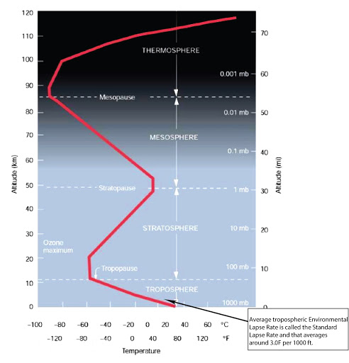

Slide 17
Exosphere
Lies above thermosphere from 500Km onwards.
It consists of things human construct, use and do in the environment.
As such there is no layer individually as ionosphere. It transits between, from about 48 km (30 mi) to 965 km (600 mi) altitude, a region that includes the thermosphere and parts of the mesosphere and exosphere.

Slide 18
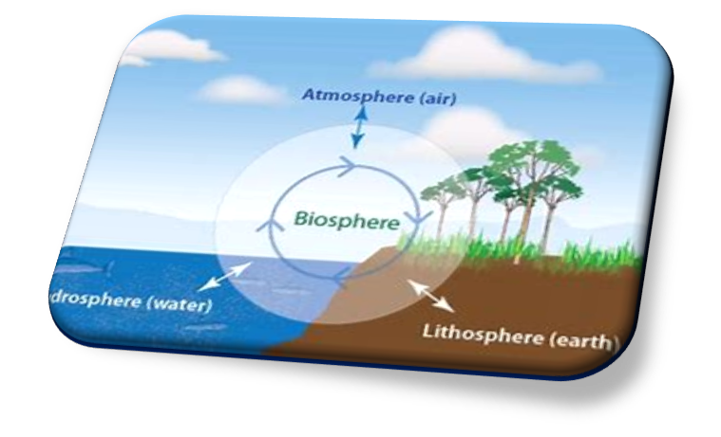
Biosphere
It refers to that part of earth in which life forms exist.
The organism comprising the biosphere is mostly found in the narrow zone of contact between the atmosphere, lithosphere and hydrosphere.

Slide 19
Multidisciplinary Nature of Environment
Environmental studies deal with working of earth, its life-support systems, its interactions, influences and solution, keeping in view the complex nature of environment, knowledge and information from various disciplines of science, law and engineering have to be included in environmental studies to understand it.
Existence and behaviour of living and non-living constituents of the environment are covered by laws of physical, chemical, geological and biological sciences.
Human behaviour and management of human societies are covered by physiological, political and social sciences.
Rules framed for maintenance of environment in a healthy state come under jurisdiction of national legislation while agreements reached regarding common problems of two or more than two countries come under purview of international law.

Slide 20
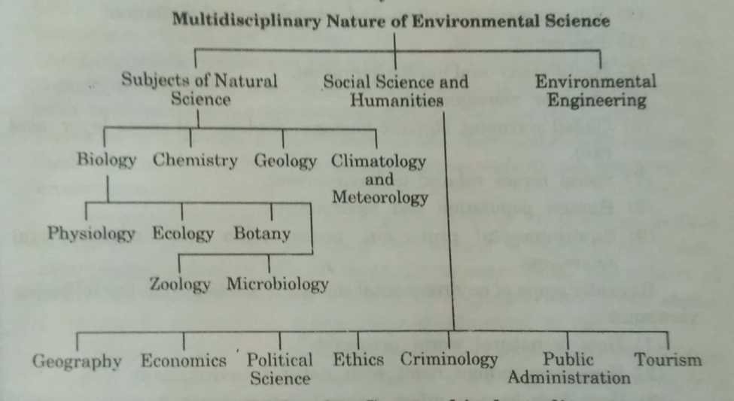
Figure showing the Multidisciplinary nature of Environmental science/studies

Slide 21
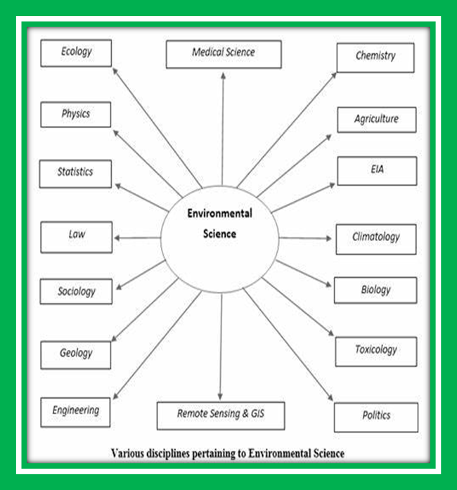
Figure showing the Multidisciplinary nature of Environmental science/studies

Slide 22
Scope of Environmental Science/Environmental studies
We live in natural surrounding (forest, river, mountain, etc.) surrounded by renewable (forest and water) and non-renewable (minerals and oil) resources.
Due to increase in population these resources are getting depleted gradually.
There is a need to understand, make ourselves aware of our natural assets and get concerned about our environment and sustainable use of the resources.
Scope of environmental studies is very wide and nearly covers aspects of every major discipline (biology, chemistry, physics, geography, resource management, economy, etc.)
In India and worldwide, environmental experts are focusing on moving from Environmental Education to Education for Sustainable Development, which emphasizes more on sustainable development.

Slide 23
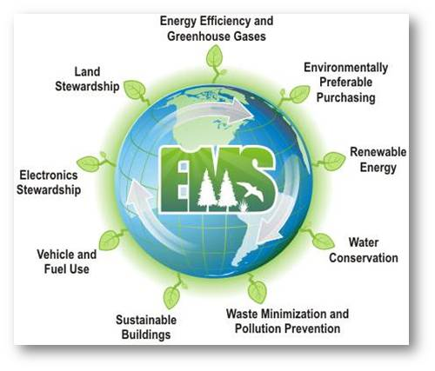
Figure showing the scope of Environmental science/studies

Slide 24
Importance of Environmental Science
The growing complexity of environmental problems is creating a need for scientists with rigorous, interdisciplinary training in environmental science. Environmental scientists and specialists use their knowledge of the natural sciences to protect the environment and human health. They must have a solid background in economics, sociology, and political science.
To realize that environmental problems are global.
To understand the impacts of development on the environment.
To discover sustainable ways of living.
To utilize natural resources efficiently.

Slide 25
To shed light on contemporary concepts such as how to conserve biodiversity.
To learn and create awareness about environmental problems at local, national and international levels.
Water, air, soil, forests are all part of our life support systems. Without them life itself would be impossible.
Natural resources are limited in nature and continue to shrink and may be get depleted if not utilized in a sustainable manner.
Almost every act of human beings creates some effect on environment: solid waste, water pollution, air pollution, soil pollution etc. and these have ill-effect on human health.

Slide 26
Need for Public Awareness
1.Humans are responsible for depletion of the natural resources; degradation of the vital life-supporting systems (like air, water, soil, etc.); ecological imbalance; deteriorated environment, etc.
2.To get rid of environmental problems, environmental awareness is imperative. It ensures that everyone knows about the consequences of his activities on nature.
3.The main objectives of creating awareness among people on environmental problems and conservation should be:-
a) improving the quality of environment

Slide 27
b) creating such an atmosphere so that people find themselves fit enough to participate in decision making so that developmental program are presented after evaluation.
c) Earth’s resources are dwindling and our environment is being increasingly degraded by human activities and hence something needs to be done.
d) Government alone cannot perform all the clean-up functions.
e) Individual/group efforts in their own every possible way have to be made to protect our environment.
f) Mass public awareness: newspapers, radio, television strongly influences public opinion on conserving our environment.

Slide 28
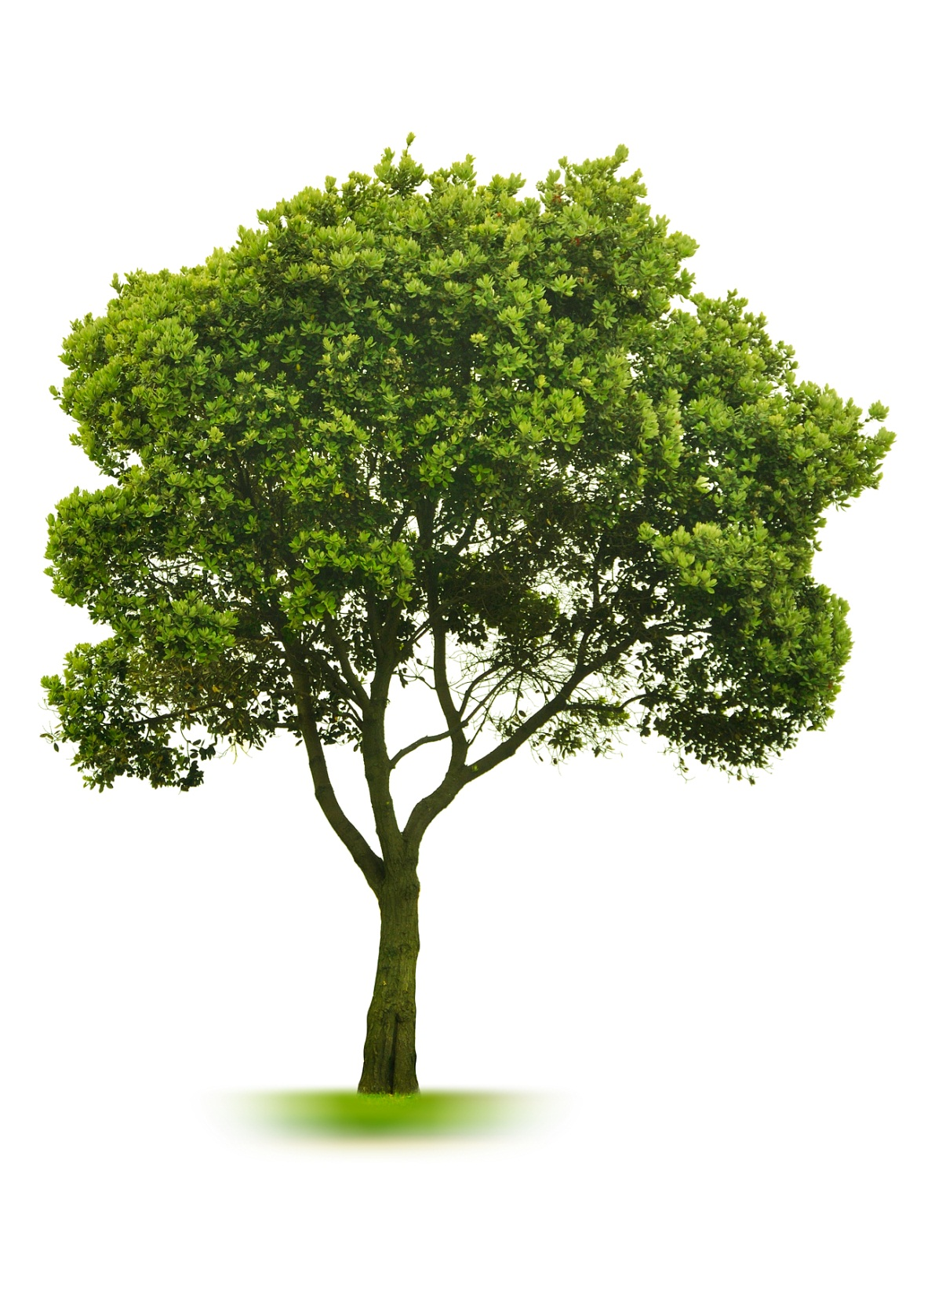
hanks…,,,,
FOR YOUR KIND ATTENTION

