Slide 1
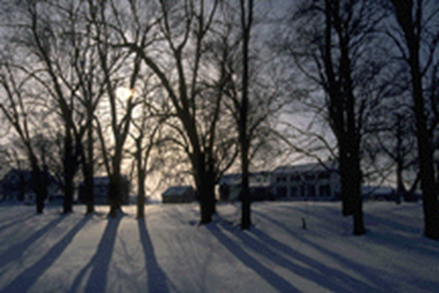
ECOSYSTEM
FAHEEM AHAMAD
Assistant Professor
SWAMI VIVEKANAND SUBHARTI UNIVERSITY
MEERUT-250005, UTTAR PRADESH, INDIA
Notes:
1
1

Slide 2
What is an Ecosystem?
The term ‘eco' means the environment and ‘system’ means an interacting interdependent complex.
The concept of ecosystem was first proposed by A.G. Tansley in 1935.
He defined ecosystem as “The system resulting from the interaction of all living and non-living factors of the environment.”

Slide 3
According to odum ecosystem is fundamental functional unit of organism and their environment.
According to R. L. Lindman, “The term ecosystem composed of physical, chemical and biological processes within a specific time unit of any magnitude.
An ecosystem is a natural unit consisting of all plants, animals and micro-organisms (biotic factors) in an area functioning together with all of the non-living physical (abiotic) factors of the environment.

Slide 4
The branch of science that deals with the study of interactions between living organisms and their physical environment is called as ‘Ecology’, or the study of ecosystems is called ‘Ecology’.
The term ‘Ecology’ was coined by a German biologist Earnst Haeckel in 1869.
The term ‘Ecology’ is derived from the greek word “Oikology” in which Oikos = home and logos = study.

Slide 5
Important characteristics of Ecosystem
Ecosystem is always dynamic.
Ecosystem is a functional unit.
Biotic and abiotic substances of ecosystem are inter-related.
An ecosystem has four trophic levels through which energy and nutrient flow occurs-
First level-Primary producer
Second level- Primary Consumer
Third level- Secondary Consumer
Fourth level- Omnivores

Slide 6
Types of ecosystem
Natural
1.Terrestrial ecosystems (grasslands, forests, desert ecosystems)
2.Aquatic ecosystem
a. Lentic (Stagnant water) like lake, ponds etc.
b. Lotic (Flowing water) like river, ocean, sea, etc.
Artificial
1.A crop land, garden, aquarium, park, kitchen garden.

Slide 7
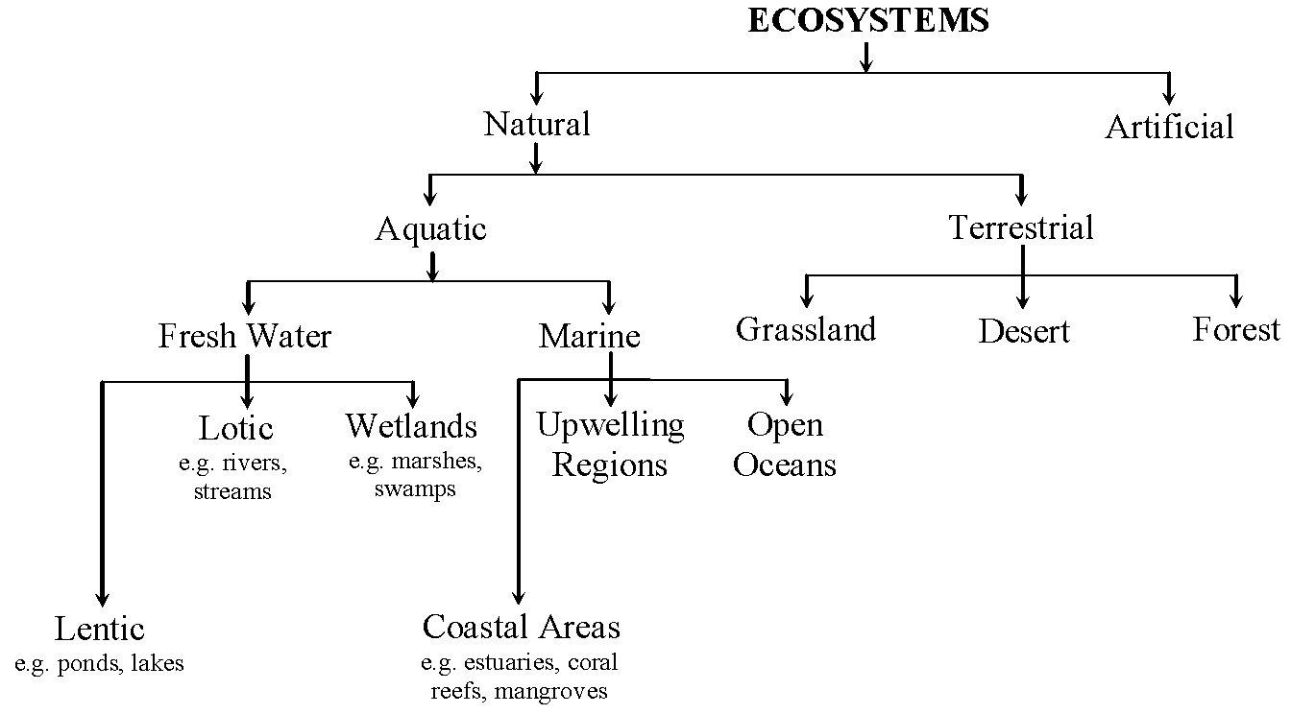

Slide 8
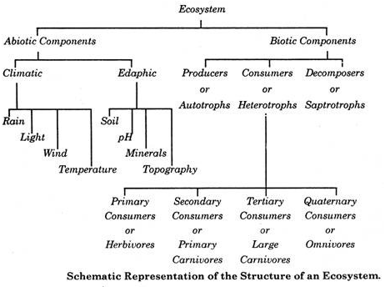
Components of Ecosystem

Slide 9
An ecosystem consists of two main components
Abiotic or Non-living components.
1. Inorganic substances (soil, water, carbon, oxygen, nitrogen, carbon-dioxide, carbonate, phosphate etc.)
2. Organic substances (Lipid, protein, carbohydrate, chlorophyll etc.)
3. Climatic factors (sunlight, shade, intensity of solar influx, duration of sun hours, average temperature, annual rainfall, wind, latitude, altitude, soil type, water availability, water current etc.)

Slide 10
Biotic or Living components.
1. Autotrophs or Producers
a. Autotrophs (Autos= self and troph=nutrition)
b. They are mainly green plants which can synthesize their food themselves with the help of photo synthesis.
b. Autotrophs are of two types.
I-Photoautotrophs (green plants)
(Photo=sunlight, autos= self and troph=nutrition)
II-Chemoautotrophs (Sulphur eating bacteria)
(Chemo=chemical, autos= self and troph=nutrition)

Slide 11
2. Heterotrophs or Consumers: They are unable to synthesize their food themselves so depend for their food requirement on producer. They are of the following types-
a. Herbivore or plant-eaters or primary consumer
(gras-hopper, rodents, cattle, man etc.)
b. Carnivore or meat-eaters or secondary consumer
(lion, tiger, wolf, frog etc.)
c. Omnivores
(human, rat, fox, many birds etc.)

Slide 12
d. Detritivores
a. They feed on the parts of organism, waste of living organism, their caste-offs and partially decomposed matter.
b. They convert organic matter into organic matter.
c. Ex- (beetles, termites, ants, crabs, earthworms, vulture etc.)
3. Decomposers or Saprotrophs
a. They derive their nutrition by breaking down the complex organic molecule to simpler organic compounds and ultimately into inorganic nutrients.
b. Ex- (virus, bacteria, fungus etc.)

Slide 13
FUNCTIONS OF AN ECOSYSTEM
Ecosystem has both structure and function.
The structure is related to the species diversity.
The function of ecosystem is related to the flow of energy and cycling of materials through structural components of ecosystem.

Slide 14
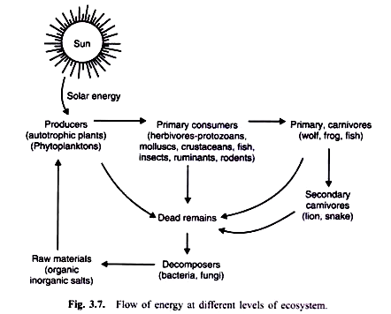

Slide 15
The Producers, the green plants, fix radiant energy (solar energy) and with the help of minerals taken from their edaphic (soil where they grow) or aerial environment, build up complex organic matter. These are their food. So, with the help of solar energy they convert the chemical energy of the food to kinetic energy and finally heat energy.
The animals eat up plants and other animals as food. So, the energy is transferred through food to animals.
When plants and animals die, then decomposers (like certain bacteria and fungi) act on their dead bodies and decompose them into simple materials like carbon dioxide, water and minerals which go back to air, water bodies and soil from where they were taken.

Slide 17
ENERGY FLOW THROUGH THE ECOSYSTEM
The original source of energy is the energy from the sun.
The flow of energy in an ecosystem follows the two laws of thermodynamics-
1st Law of thermodynamics- Law of conservation of energy.
2nd Law of thermodynamics- Energy dissipates as it is used or at every level there is about 90% loss of energy as heat or in some other form and the energy transferred from one trophic level to other is only about 10%. This is known as “Rule of ecological tenth”.

Slide 19
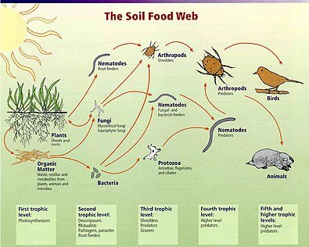

Slide 20
Ecological Pyramid
It is a graphic representation of the relationship between organisms at various trophic levels in a food chain. The basis of an ecological pyramid is the biomass, energy, and number. Just as the name suggests ecological pyramids are in the shape of a pyramid. The concept was first introduced by Charles Elton, the pioneer British Ecologist.

Slide 21
Types of Ecological Pyramids
Depending on the factors that we use to represent an ecological pyramid, there are three types. They are:
Pyramid of numbers– Here the factor that is taken into account is the number of organisms in each trophic level. As we go up the levels of the pyramid, the number of organisms decreases. The producers form the largest number and hence are at the bottom of the pyramid.
Pyramid of energy– This is an upright pyramid that represents the flow of energy from the producers to the final consumers.
Pyramid of biomass – This pyramid represents the amount of biomass of the organisms present at each trophic level. Biomass is nothing but the weight of the organisms.

Slide 22
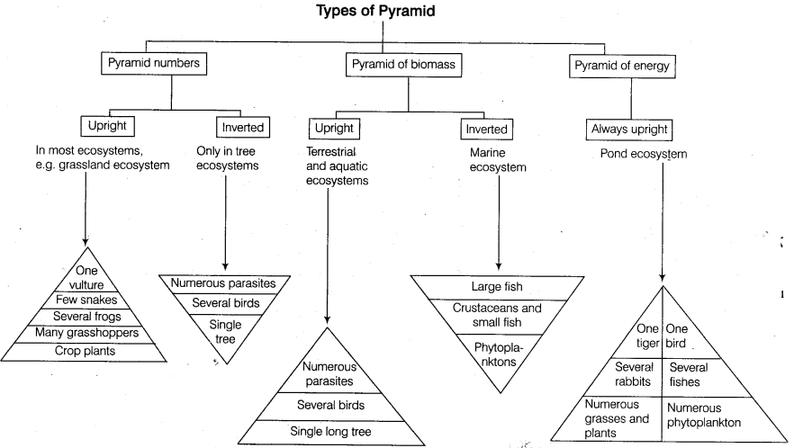

Slide 23
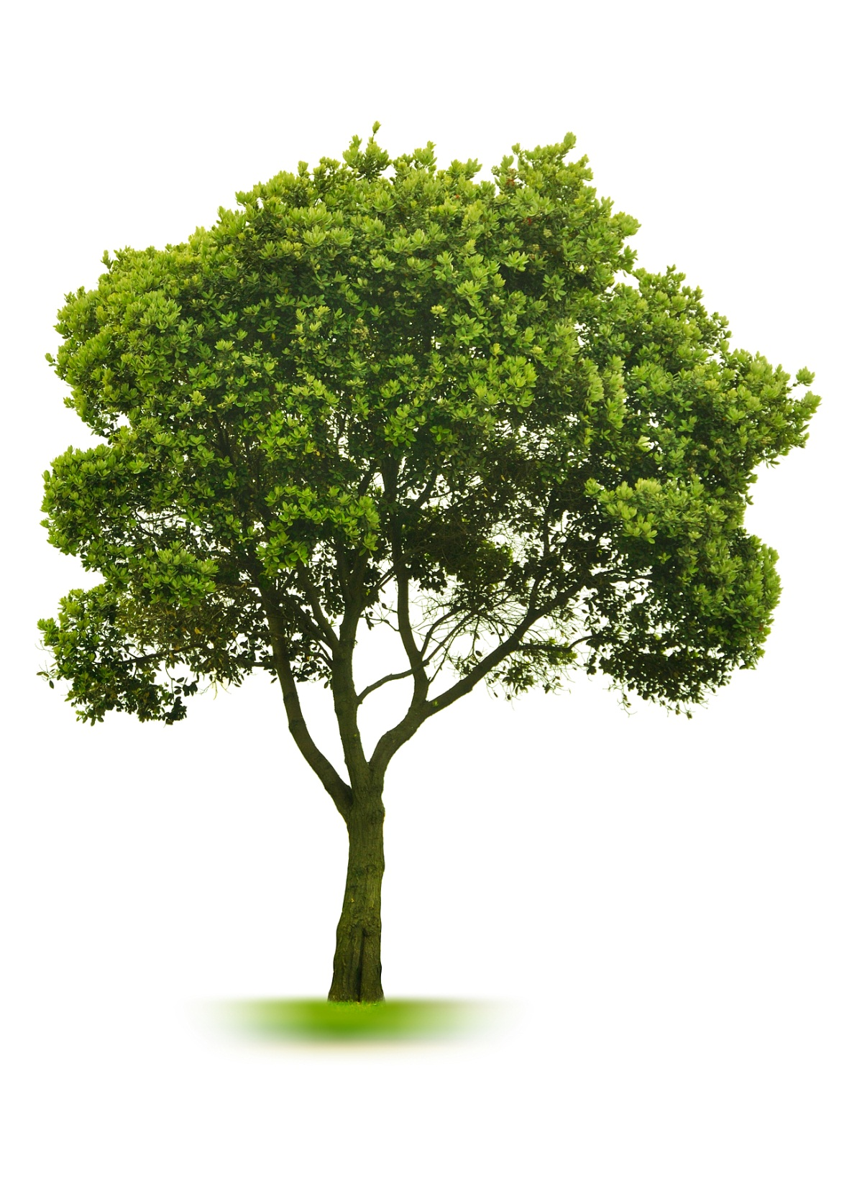
hanks…,,,,
FOR YOUR KIND ATTENTION

